Slide 1
To a small boy
who died at
Diepkloof Reformatory
Alan Paton

Slide 2
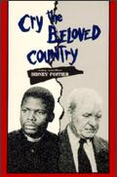
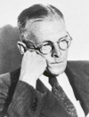
Headmaster at Diepkloof Reformatory from 1935-1935

Slide 3
Diepkloof:
Situated in Soweto
Reformatory:
An institute for young offenders. They were send here to change their behaviour.

Slide 4
The poem is an elegy.
You give an elegy at a funeral to say something about the person who has died.

Slide 5
In this poem the poet talks about a small boy who has just died.
He must bury the boy.
He talks about :
What the boy did wrong
Who were involved in sending the boy there
What happened when the boy died
What they knew about the boy
The funeral
Life after death

Slide 6
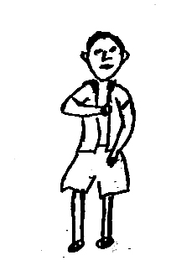
Line 1:
Small offender, small innocent child
The offence (crime) that was committed was small
The offender (child) is small
Repetition of small: emphasizes the size

Slide 7
Line 2
With no conception or comprehension
Alliteration: c of conception or comprehension
Internal rhyme: conception comprehension
Conception: idea
Comprehension: understand
The little offender had no idea what he did wrong and what the consequences would be.

Slide 8
Line 3
Of the vast machinery set in motion
Metaphor:
All the people working on the child’s case after he was caught is compared with a big (vast) machine.
Once this machine was set in motion there was no way out for the child.

Slide 9
Line 4
By your trivial transgression
Trivial: not important, not serious
Transgression: action breaking a law

Slide 10
Line 5
Of the great forces of authority
The child does not know which forces with power is involved in the case.
Forces: having great influence
Authority: people in charge, people who can make decisions that will influence your life.

Slide 11
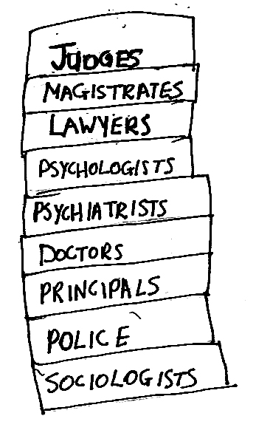
Line 6-8
Of judges, magistrates, and lawyers,
Psychologists, psychiatrists, and doctors
Principals, police and sociologist
The boy was seen by all these people.
Note the alliteration.

Slide 12
Line 9
Kept moving and alive by your delinquency,
Delinquency: unlawful behaviour by young people
All the people mentioned had work to do because of what the little boy did.

Slide 13
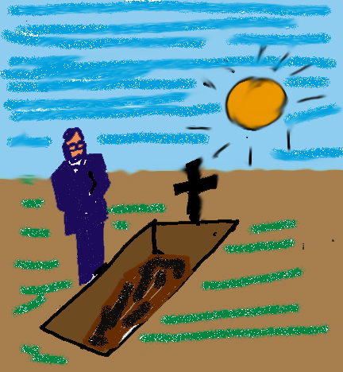
Line 10-11
This day, under the shining sun
Do I commit your body to the earth
The boy is being buried on a lovely day.
Alliteration: shining sun
“do I commit” is the same words a judge uses to sentence you to prison

Slide 14
Line 12
Oh child, oh lost and lonely one.
Apostrophe: the poet talks directly to the child by saying “Oh child”
Alliteration: lost and lonely
He emphasizes how alone this child was.

Slide 15
Line 13
Clerks are moves into action by your dying:
Now that the boy is dead another group of people are put to work.
The boy is never treated as a person but as a file, a number.

Slide 16
Line 14-15
Your documents, all neatly put together
Are transferred from the living to the dead
Boy nr. 4168
To the clerks the boy is just a file being moved from the living cabinet to the cabinet for the dead.

Slide 17
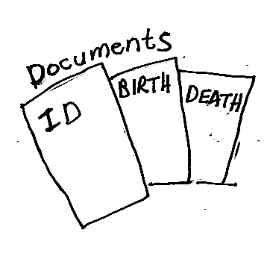
Line 16-17
Here is the document of birth
Saying that you were born and where an when,
The poet shows us what is in the file of the boy.
The documents say nothing personal, it gives only impersonal details.

Slide 18
Line 18-21
But giving no hint of joy or sorrow,
Or if the sun shone, or if the rain was falling,
Or what bird flew singing over the roof
Where your mother travailed.
The information gives only statistic, no personal information. By reading these files the boy will only be a name and number. You won’t know the boy.

Slide 19
Line 21-23
…And here your name
Meaning in white man’s tongue, he is arrived
But to what end or purpose is not said.
Even his name, which has a meaning, has lost its meaning.
The boy arrived but nobody knows why.

Slide 20
Line 24-25
Here is the last certificate of death
Forestalling authority he sets you free,
The certificate of death has the most power of all the documents. It has more power than all the authorities because it sets the boy free. In death no one can touch the boy again
If the boy completed his sentence in the Reformatory he would have been set free. Death set him free first.

Slide 21
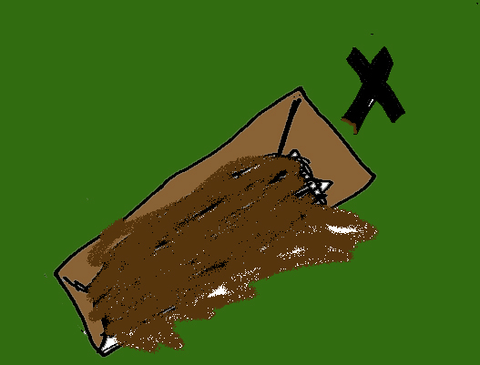
Line 26-28
You that did once arrive have now departed
And are enfolded in the sole embrace
Of kindness that earth ever gave to you.
The boy who once arrived on earth, leaves earth now.
As they bury him, he receives his one and only embrace ever. The earth hugs him.

Slide 22
Line 29
So negligent in life, and death belatedly
It was negligent of everybody never to give the boy any hugs when he was still alive. Now it is too late. The hug he receives from mother earth is too late.

Slide 23
Line 30-34
She pours her generous abundance on you
And rains her bounty on the quivering wood
And swaddles you about, where neither hail nor tempest,
Neither wind nor snow nor any heat of sun
Shall offend you
Now that the boy is dead, earth gives the boy everything. Great amounts of sand fall on the coffin. Once the boy is covered in the grave nothing can hurt the boy again, not storm, no hail, wind, snow, sun or heat shall hurt the boy.
This is ironic. They boy was not in the Reformatory because of the earth’s elements but because of people.

Slide 24
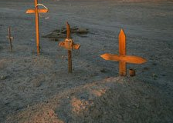
Line 34-37
… and the thin cold spears
Of the highveld rain that once pierced you
In falling on your grave shall press you closer
To the deep repentant heart
The rain that once hurt the boy will now press the earth closer to the boy.
Earth will feel sorry for the way the boy have been treated.

Slide 25

Line 38
Here is the warrant of commital
For this offence, oh small and lonely one,
In the file is the warrant that sent the boy to Diepkloof Reformatory.

Slide 26
Line 40-42
For this offence in whose commission
Millions of men are in complicity
You are committed. So do I commit you
Many men are responsible for this boy’s death. The same way the boy was committed to the Reformatory he is now committed to the grave.

Slide 27
Line 43-45
Your frail body to the waiting ground,
Your frail body to the waiting ground,
Your dust to the dust of the veld,
The ground is waiting not only for this boy but for all of us.
The boy will become part of the earth in death.

Slide 28
Line 46
Fly home-bound soul to the great Judge-President
Great Judge-President: God
Every country has a judge president that can override all court decisions and set you free.
This boy must wait to go to God.

Slide 29
Line 47-49
Who unencumbered by the pressing need
To give society protection, may pass on
The sentence of the indeterminate compassion
Unencumbered: don’t seem worried
God does not seem to care about society’s problems. God will however give unending compassion to the boy when he arrives in heaven.
His earthly sentence will be replaced by a heavenly one of compassion.

